Slide 1
PCEP Extensions for Segment Routing leveraging the IPv6 data plane
draft-negi-pce-segment-routing-ipv6-00
Mahendra Singh Negi | Huawei
Prejeeth Kaladharan
Dhruv Dhody
Siva Sivabalan | Cisco

Slide 2
Introduction & Motivation
Segment Routing (SR) can be used to steer packets through an IPv6 or MPLS network using the source routing paradigm.
Since SR can be applied to both MPLS and IPv6 data plane
Should a PCE be able to compute SR-Path for both MPLS and IPv6 forwarding plane?
And thus should PCEP be able to do this?

Slide 3
PCEP for SRv6
Segment Routing can be applied to the IPv6 the Segment Routing Header (SRH).
Segment identified by an IPv6 address
Making it an ordered list of IPv6 addresses in the routing header
This document extends [I-D.ietf-pce-segment-routing] to support SR for IPv6 data plane.
Extend SR-ERO, SR-RRO subobjects for SRv6
Capability advertisement for SRv6 in PCEP
A new path setup type

Slide 4
PCEP Messages
No change here, all messages remains the same –
PCReq
PCRep
PCRpt
PCUpd
PCInitiate
Only,
The ERO object will use SR-ERO sub-object extended for SRv6
The RRO object will use SR-RRO sub-object extended for SRv6

Slide 5
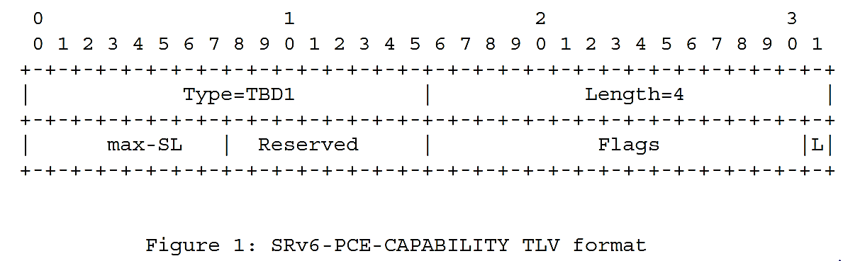
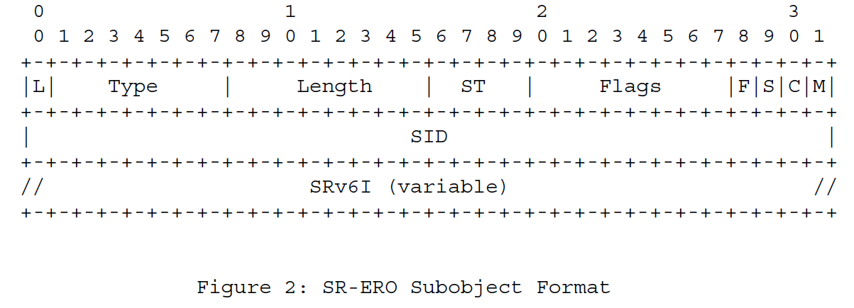
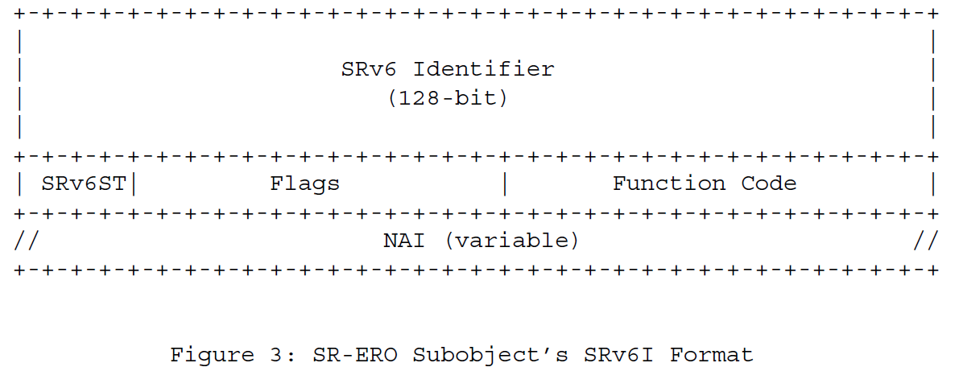
PCEP Extn
SRv6-PCE-CAPABILITY TLV in OPEN
A new PST value for SRv6, carried in PATH-SETUP-TYPE TLV in RP/SRP object
SR-ERO Sub-object extended
a new SID Type (ST)
SRv6 Identifier (SRv6I) is the 128 bit IPv6 addresses representing SRv6 segment.
SRv6ST indicates NAI
Fn Code indicates function associated with SRv6 SID
NAI - IPv6 Node ID or IPv6 Adjacency (optional)

Slide 6
Next Steps
With this draft, we are making sure that the PCE and the PCEP can be used for both modes of SR
Straight forward extension to existing SR work in PCEP
What does the WG think?
Comments?

Slide 7


